Slide 1
Compassion Project

Slide 2
What is compassion?
What is compassion?
Com =Together
Passion = Suffering
Passion is a STRONG feeling
https://www.youtube.com/watch?v=9-UZ0hn_Tpc

Slide 3
How does compassion leave a lasting impression on the giver and receiver?

Slide 4
Compassion Project Steps:
Determine Driving Question
Think critically and do research
Collaborate with others
Communicate with others
Share your learning
Integrate technology

Slide 5
What is your Driving Question?
Driving Question is what your family wants to answer. It must be majority consensus. It must be agreeable by all members of the family.
Ideas: How can I provide companionship to someone? (Specify target audience)
How can I be compassionate for those in need? (Specify target audience)
How does a conversation with _________________ build a compassionate relationship?
Come up with your own driving questions

Slide 6
Other Steps
Critical Thinking and Research: Talk as a family, ask questions, think about the question you want to use, go out and demonstrate your compassion, answer your Driving Question.
Collaboration: This is a family project with a short turn around. BE AWARE of deadlines.
Communication: Share your digital product with your class.
Sharing: Digital presentation: Everyone in your family must be PART of the presentation. It should be less than 5 minutes.
Technology Integration: Computers, video cameras, phones...etc.

Slide 7
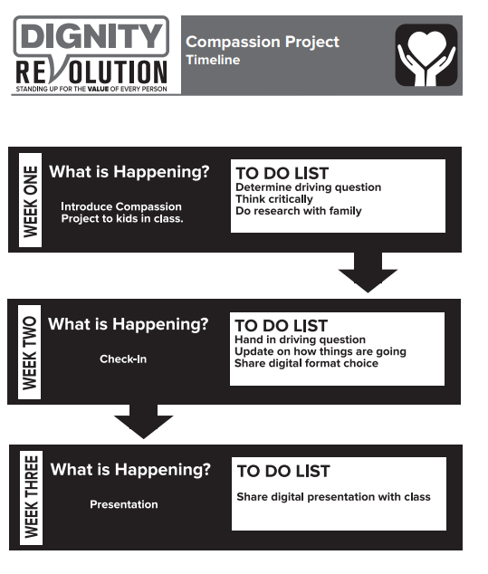
Timeline

Slide 8
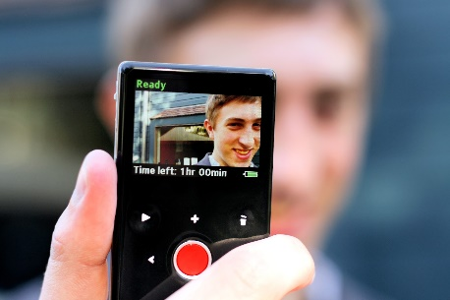
Digital Presentation

Slide 9
