Slide 1
The System Isn’t Working

Slide 2
The 7 P’s
Identity based on external qualities.

Slide 3
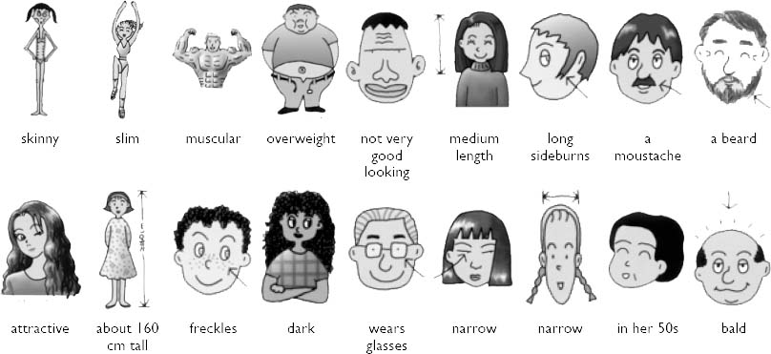
Physical Appearance What you look like.

Slide 4
Performance How well you do or how successful you are.

Slide 5
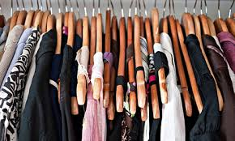
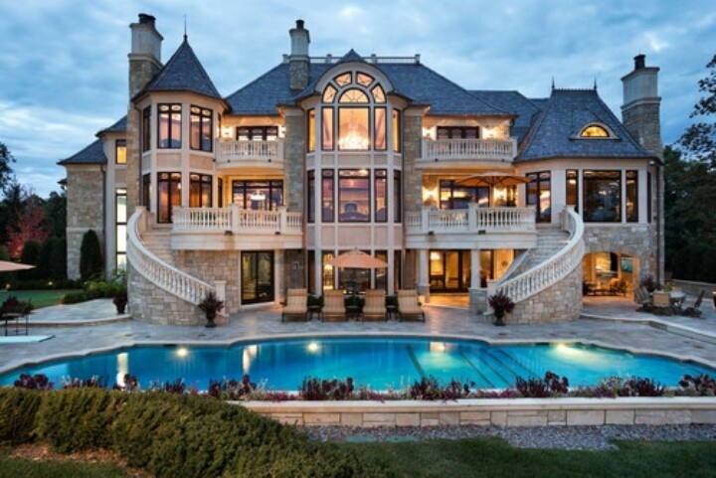
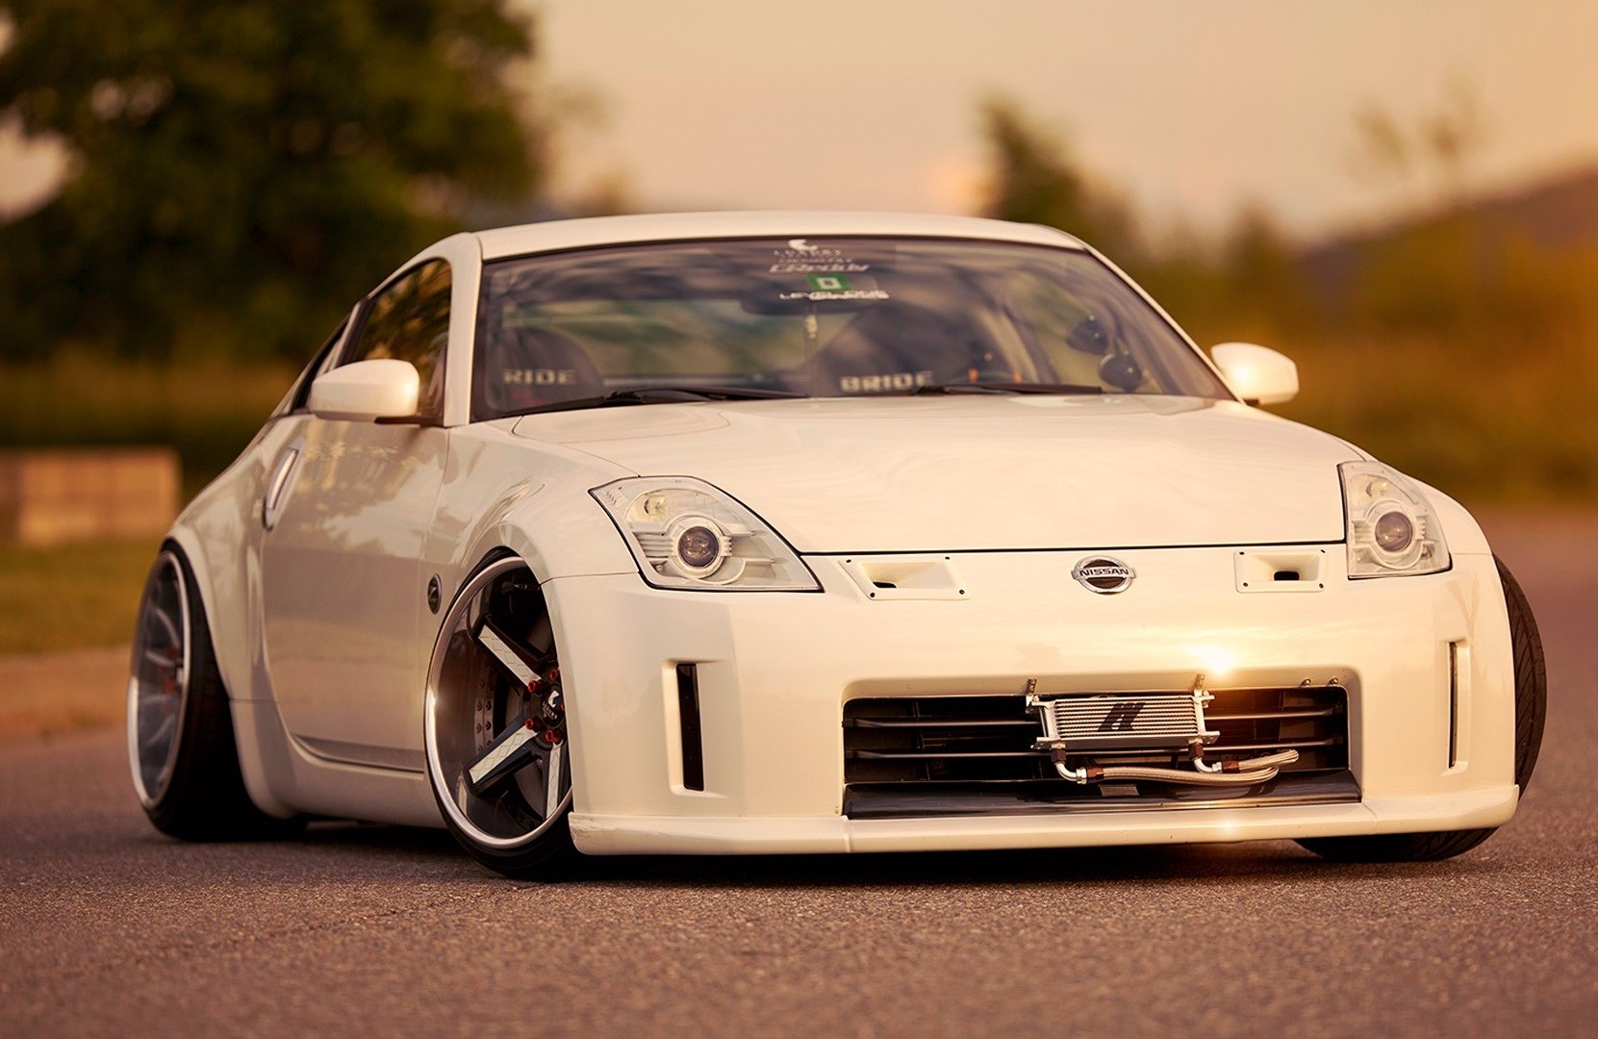
Possessions The clothes you wear, the car you drive, the house you own.

Slide 6
Popularity How many friends you have.

Slide 7
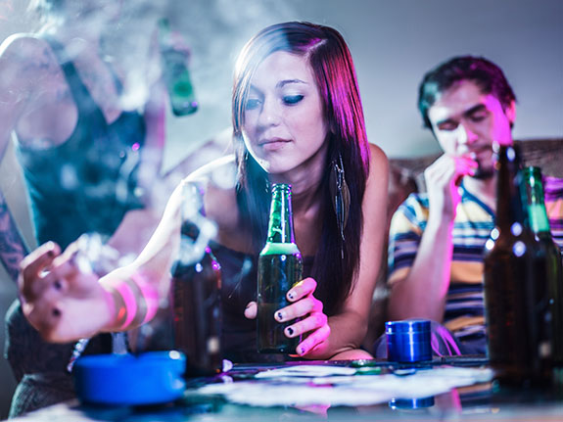
Pleasure Doing what you want, when you want, because it feels good.

Slide 8
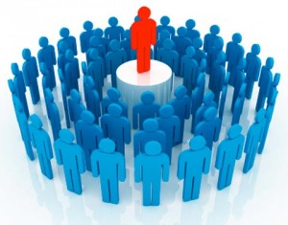
Prestige How recognized or respected you are.

Slide 9
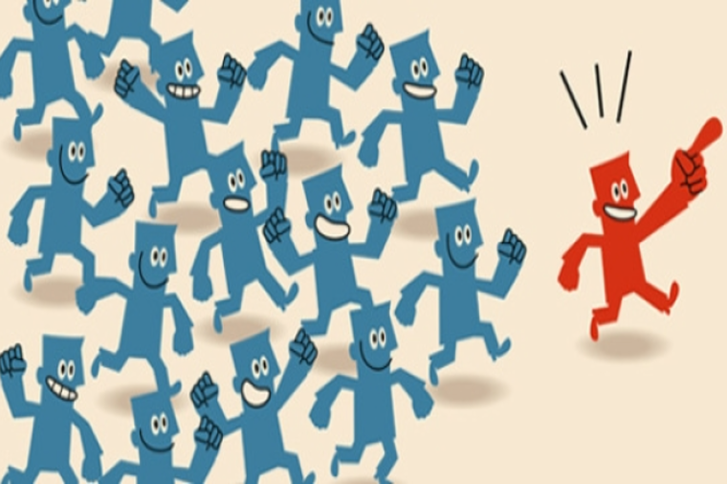
Power How much influence you have over others.

Slide 10
7 C’s
Identity based on internal qualities of love.

Slide 11
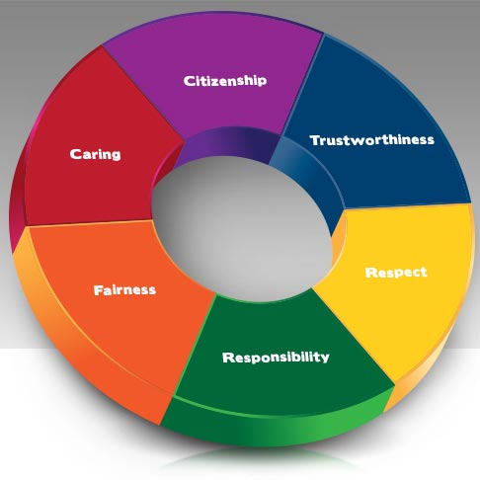
Character Know who you are as a whole person.

Slide 12
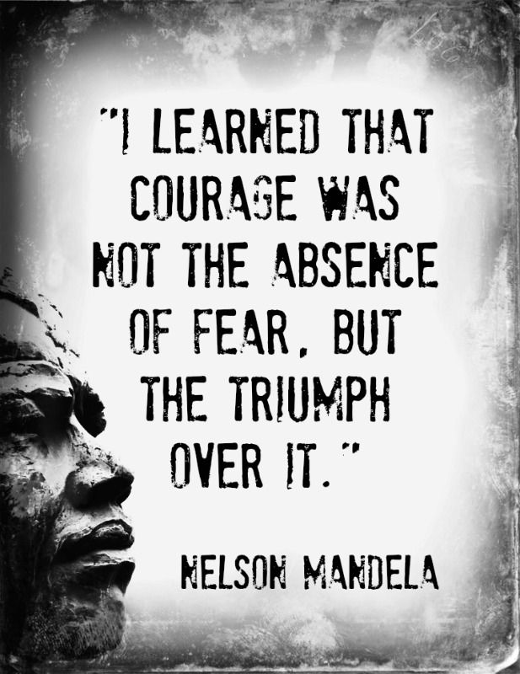
Courage Stand up for what is right and what you believe.

Slide 13
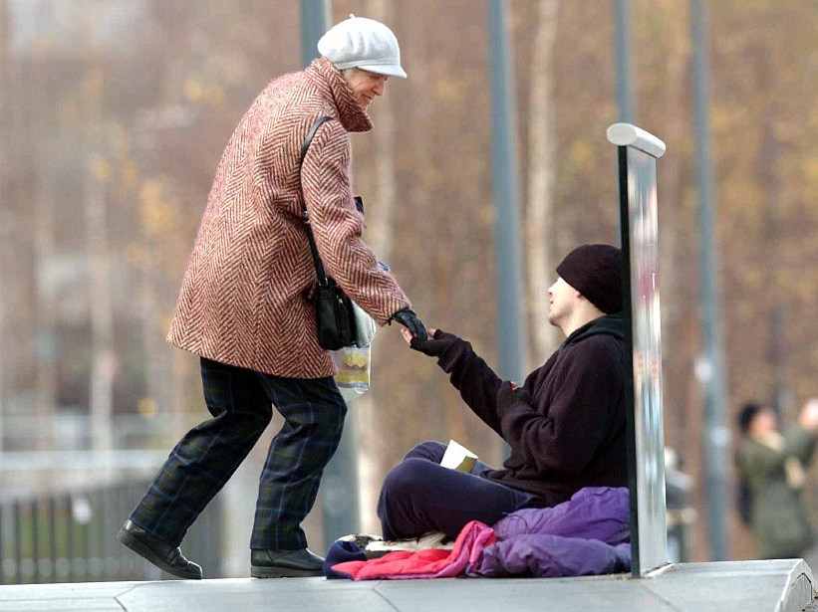
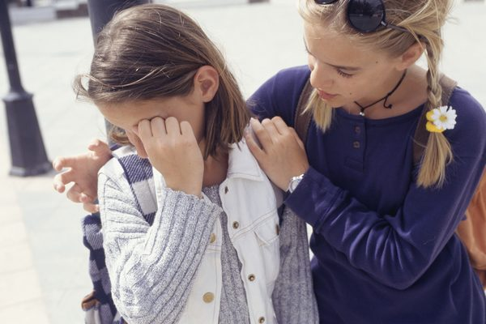
Compassion Concern for others as well as self. Strive for justice.

Slide 14
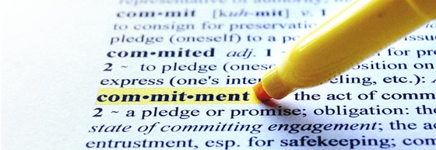
Commitment Stand by friends through adversity. Keep promises and overcome differences.

Slide 15
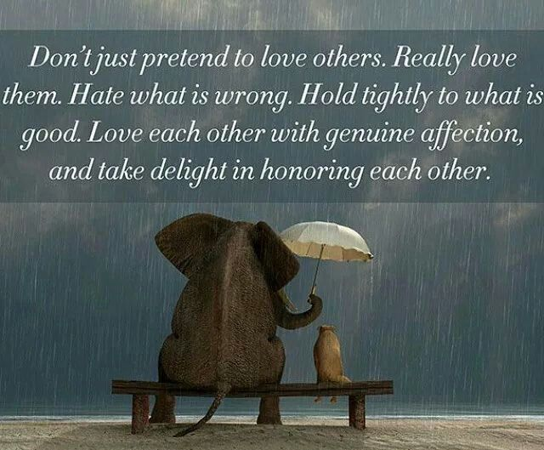
Consistency Live life without hypocrisy. Support words with action.

Slide 16
Creativity Celebrate individuality and use unique talents to benefit the wider community.

Slide 17
Charity Love life and others as well as yourself.

