Slide 1
Optical Illusions

Slide 2
www.empathicperspectives.wordpress.com

Slide 3
Wow.mx

Slide 4
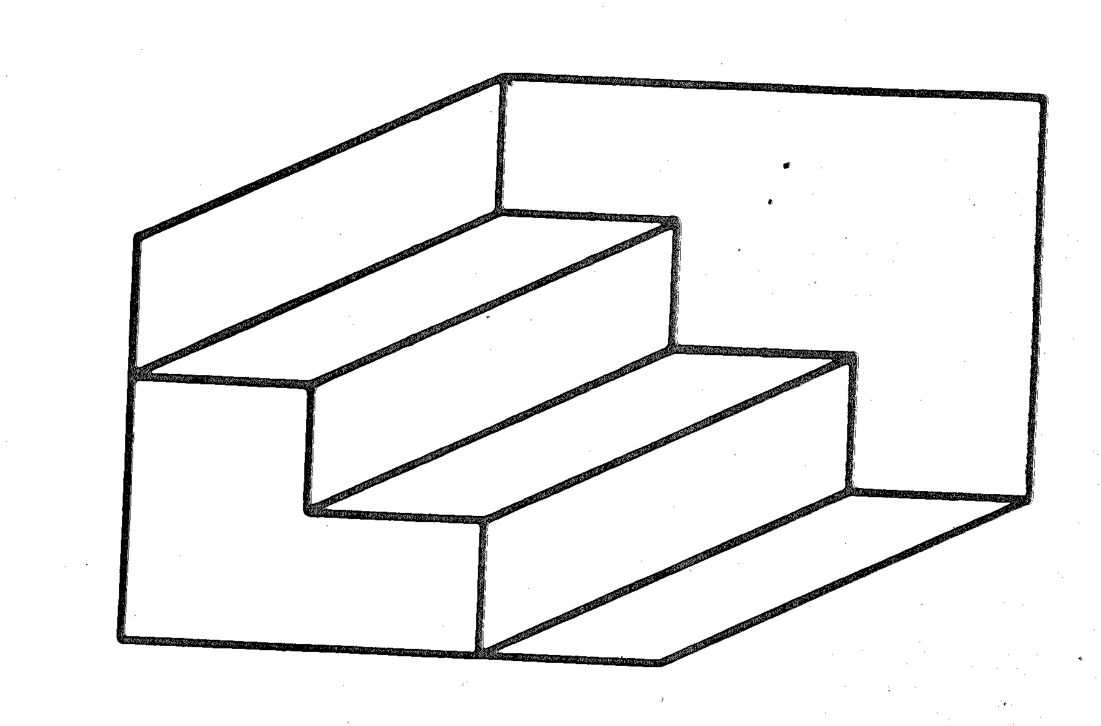
www.Wikipedia.org

Slide 5
www.moillusions.com

Slide 6
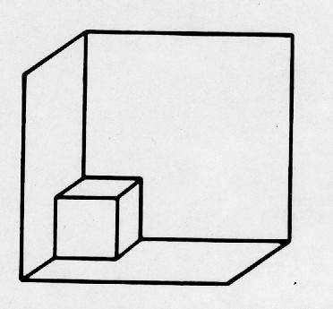
www.Blog.excelhero.com

Slide 7
www.blacksunsoftware.com

Slide 8
www.Wikipedia.org

Slide 9
www.eyetricks.com

Slide 10
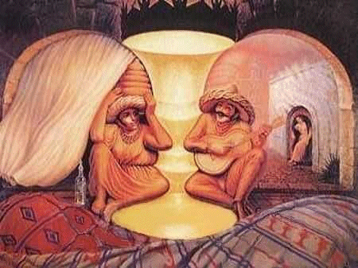
www.moillusions.com

Slide 11
www.discovery-zone.com

Slide 12
www.brainden.com

Slide 13
www.brainpages.org

Slide 14
www.magictricks101.blogspot.com

Slide 15
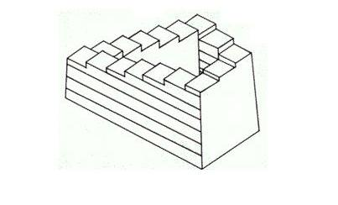
www.newopticalillusions.com

Slide 16
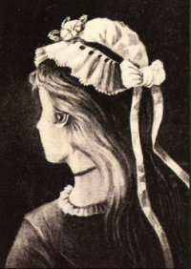
www.puzzles.about.com

Slide 17
What is the comparison between optical illusions and a depressed or suicidal person?

Slide 18
Warning Signs of Suicide
Withdrawal from family and friends
Drop in school grades and attendance
Change in sleep patterns
Large weight gain or loss
Unresolved grief and/or a loss
Preoccupation with death
Self destructive behavior
Change in friends/goals/health habits
Any change from normal

